Slide 1
AUTOMATIC NUMBER PLATE RECOGNITION
USING OPENCV AND EASYOCR
Guided by:
Dr Neeraj Garg
(HOD-AIML)
Co-Guided by:
Dr Neelam Sharma
(Assistant Professor)
Naman Kapoor
(00614811622)
Anupam Chand Singh
(01014811622)
Ansh Mangla
(01114811622)

Slide 2

AUTOMATIC NUMBER PLATE RECOGNITION
USING OPENCV AND EASYOCR
A TERM PROJECT
REPORT
Submitted by
(Candidate Names with Roll No.)
BACHELOR OF TECHNOLOGY
IN
ARTIFICIAL INTELLIGENCE & MACHINE LEARNING
Under the Guidance
of
(Guide Name)
(Designation, AIML)
DEPARTMENT OF ARTIFICIAL INTELLIGENCE & MACHINE
Maharaja Agrasen Institute of Technology,
PSP area, Sector – 22, Rohini, New Delhi –110085
(Affiliated to Guru Gobind Singh Indraprastha, New Delhi)
(MAY 2024)

Slide 3
MAHARAJA AGRASEN INSTITUTE OF TECHNOLOGY
Department of Artificial Intelligence &Machine Learning
CERTIFICATE
This is to Certified that this TERM PROJECT report AUTOMATIC NUMBER PLATE RECOGNITION
USING OPENCV AND EASYOCR is submitted by Naman Kapoor ( 006 ) , Anupam Chand Singh ( 010 ) & Ansh Mangla ( 011) who carried out the project work under my supervision.
I approve this TERM PROJECT for submission.
Dr. Neeraj Garg Guide/Co-Guide Name with Designation
(HoD, AI&ML) (Project Guide)

Slide 4
ACKNOWLEDGEMENT
It gives me immense pleasure to express my deepest sense of gratitude and sincere thanks to my respected guide Dr. Neeraj Garg(ASSOCIATE PROFESSOR,DEPARTMENT OF AIML) MAIT Delhi, for their valuable guidance, encouragement and help for completing this work. Their useful suggestions for this whole work and co-operative behavior are sincerely acknowledged.
I am also grateful to my teachers Dr. Neelam Sharma for their constant support and guidance. (If Required)
I also wish to express my indebtedness to my parents as well as my family member whose blessings and support always helped me to face the challenges ahead.
Place: Delhi
Date: 5 May
NAMAN KAPOOR
(SCHOLAR,DEPARTMENT OF AIML)
ANUPAM CHAND SINGH
(SCHOLAR,DEPARTMENT OF AIML)
ANSH MANGLA
(SCHOLAR,DEPARTMENT OF AIML)

Slide 5
Contents
Abstract
Introduction
Literature Survey
Objective
Techniques Used
System Requirements
Methodology
Data Flow Diagram
Result
Limitations
Future Scope
Conclusion
References

Slide 6
Abstract
ANPR technology revolutionizes license plate detection and recognition, vital in law enforcement, traffic, and security. This review delves into recent advancements, particularly emphasizing deep learning techniques for character recognition. It explores critical components such as plate localization, character segmentation, and OCR. Additionally, the paper addresses challenges, performance metrics, and future directions aimed at enhancing accuracy and efficiency in practical settings. By synthesizing existing research and identifying emerging trends, this review contributes to the broader adoption of ANPR systems in various domains, including traffic management, law enforcement, and security surveillance.

Slide 7
INTRODUCTION
Advanced technology, including machine learning and image processing, is essential for efficient traffic management and surveillance due to the surge in vehicle traffic.
Computer systems equipped with these capabilities reduce the need for human resources and handle tasks such as vehicle counting, parking violation detection, database management, and alerting for blacklisted or stolen vehicles.
Traditional methods like inductive loops and sensors are costly, cumbersome, and challenging to maintain and install, necessitating modernized approaches for road accident monitoring and management.
Robust license plate recognition systems are more efficient, enabling the identification of vehicles and their owners from vehicle images.
ANPR systems play a crucial role in toll collection, speed regulation, and proper traffic management by detecting and identifying license plates.
The core steps of an ANPR system include number plate area detection, character breakdown, and Optical Character Recognition (OCR), where characters are separated for recognition.
Numerous research papers have been reviewed to gather data on ANPR-centered applications.

Slide 8
LITERATURE SURVEY
The research gap in automated number plate recognition (ANPR) projects lies in several areas:
Real-Time Performance: While ANPR systems have made significant strides, there's still room for improvement in achieving real-time processing, especially in scenarios with high vehicle volumes or complex environments.
Accuracy and Robustness: Enhancing the accuracy and robustness of ANPR systems remains a challenge, particularly in adverse conditions such as varying lighting, weather, or plate occlusions.
Adaptability to Varied Environments: Many ANPR systems struggle with adaptability to diverse environments, including different countries with varying license plate formats, leading to reduced accuracy and performance in such settings.
Resource Efficiency: Optimizing resource usage, including computational power and memory, is crucial for deploying ANPR systems on resource-constrained devices or in distributed systems.
Privacy and Data Security: Addressing concerns related to privacy and data security is essential, especially as ANPR systems involve capturing and processing sensitive information from vehicles.

Slide 9
LITERATURE SURVEY
[1] Anmol Sasi et al."., Automatic Car Number Plate Recognition:" in 2017, This comprehensive review paper provides an overview of ANPR technology, including its history, challenges, and applications. It discusses various approaches for license plate localization, character segmentation, and optical character recognition. Additionally, it evaluates the performance of different ANPR systems and identifies future research directions.
[8]A. Sharma et al., "A Survey of Automatic Number Plate Recognition" (2018). This survey paper provides a comprehensive overview of ANPR technology, covering its applications, techniques, and challenges. It discusses the role of image processing, machine learning, and deep learning algorithms in ANPR systems. The paper also examines the impact of environmental factors such as illumination and occlusion on ANPR performance.
[4]S. Kumar et al., "Automatic Number Plate Recognition Systems: A Review" (2020). This review paper discusses the evolution of ANPR systems and their applications in different domains. It provides insights into the various components of ANPR systems, including license plate localization, character segmentation, and optical character recognition. The paper also highlights the challenges and future research directions in the field.
[8]Abhishek Kashyap et al., “Automatic Number Plate Recognition” in 2018 published at International Conference on Advances in Computing, Communication Control and Networking (ICACCCN2018).

Slide 10
OBJECTIVES
The primary objective of Automatic Number Plate Recognition (ANPR) is to automatically detect, interpret, and record license plate numbers from images or video streams captured by cameras. The key objectives of ANPR systems include:
Accurate Detection: ANPR systems aim to accurately locate and detect license plates within images or video frames, even in challenging conditions such as varying illumination, occlusions, and partial obstructions.
Efficient Recognition: Once the license plate region is detected, ANPR systems strive to accurately recognize and extract the characters or symbols on the plate using Optical Character Recognition (OCR) techniques.
Real-time Processing: ANPR systems are often deployed in real-time applications such as traffic monitoring, toll collection, and law enforcement. Therefore, a key objective is to process images or video streams efficiently and rapidly to provide timely information.
Number plate area detection
Breakdown of characters, and
Optical Character Recognition (OCR).
Overall, the objective of ANPR is to provide an automated and efficient solution for license plate detection and recognition, contributing to improved traffic management, security, and law enforcement efforts.

Slide 11
TECHNIQUES USED
Automatic Number Plate Recognition (ANPR) systems utilize a variety of technologies, including:
Image Processing: Traditional ANPR systems often employ image processing techniques such as edge detection, morphological operations, and template matching to locate and extract license plate regions from images or video frames.
Optical Character Recognition (OCR): OCR algorithms are used to recognize and extract the characters or symbols on the detected license plates. OCR techniques may include pattern recognition, feature extraction, and machine learning-based approaches to accurately interpret the alphanumeric characters.
CNN, YOLO(You Only Look Once), SSD: Deep learning techniques, particularly Convolutional Neural Networks (CNNs), have shown remarkable success in ANPR tasks. CNN architectures such as YOLO (You Only Look Once), SSD (Single Shot Multibox Detector), and Faster R-CNN (Region-based Convolutional Neural Network) are commonly used for accurate and efficient license plate detection.
OpenCV-OpenCV Library is used for the detection of the number plate.
Feature Extraction: Feature extraction methods, such as Histogram of Oriented Gradients (HOG), Local Binary Patterns (LBP), and Scale-Invariant Feature Transform (SIFT), are used to capture distinctive characteristics of license plates for detection and recognition purposes.
Camera Systems: ANPR systems rely on camera systems to capture images or video streams of vehicles and license plates. These camera systems may include fixed cameras installed at specific locations, mobile cameras mounted on vehicles, or surveillance cameras integrated into traffic infrastructure.
By integrating these technologies, ANPR systems can accurately and efficiently detect, recognize, and record license plate information, contributing to various applications such as traffic management, toll collection, parking enforcement, and law enforcement.

Slide 12
SYSTEM REQUIREMENTS
The system requirements for an Automatic Number Plate Recognition (ANPR) system can vary depending on factors such as the intended application, scale of deployment, and desired performance criteria. However, here are some general system requirements typically considered when designing and deploying an ANPR system:
Hardware Requirements:
Camera(s): High-resolution cameras capable of capturing clear images or video streams of vehicles and license plates, with features such as adjustable focus, zoom, and infrared capability for nighttime operation.
Processing Unit: Sufficient computational power, such as multi-core processors or GPUs, to perform real-time image processing, feature extraction, and deep learning computations.
Memory: Adequate RAM to store and manipulate image data, feature descriptors, and model parameters efficiently.
Storage: Sufficient storage capacity, either on local disks or cloud-based storage services, to store captured images, video recordings, and associated metadata.
Networking: Reliable network connectivity for data transmission, communication with external databases or servers, and remote monitoring/control of the ANPR system.
Notes:
Consider talking about:
Meta-research
Methods of research
Linguicism
Publication peer review
Influence of the open-access movement
Future perspectives

Slide 13
SYSTEM REQUIREMENTS
Software Requirements:
Image Processing Libraries: Software libraries for image processing tasks such as edge detection, image enhancement, and noise reduction.
Deep Learning Frameworks: Frameworks such as TensorFlow, PyTorch, or OpenCV for implementing deep learning models for license plate detection and recognition.
OCR Engines: Optical Character Recognition (OCR) engines or libraries capable of accurately recognizing alphanumeric characters on license plates.
Database Management System: Software for managing and querying databases to store vehicle and license plate information, including vehicle registration details, timestamps, and event logs.
Operating System: Compatible operating system platforms such as Linux, Windows, or macOS, depending on the specific software requirements and preferences of the users.
Notes:
Consider talking about:
In Russia

Slide 14
METHODOLOGY
We utilized neural networks for Automatic Number Plate Recognition (ANPR), leveraging various Python libraries such as EasyOCR and OpenCV for image recognition and number plate reading. Our dataset was sourced from Kaggle. Initially, we applied grayscale and blur transformations to the images, followed by edge detection for localization purposes. Subsequently, we identified contours and applied masks to the images. Finally, we employed EasyOCR to extract text from the processed images.

Slide 15
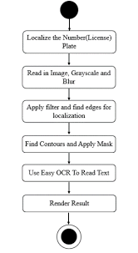
DATA FLOW DIAGRAM

Slide 16
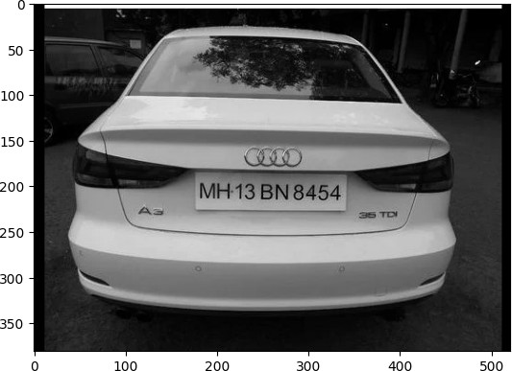
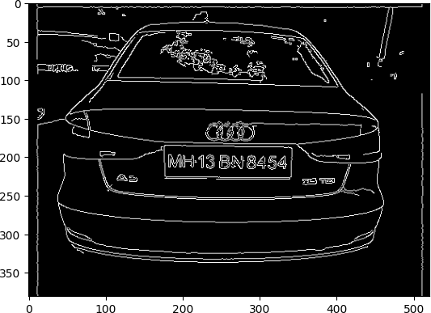
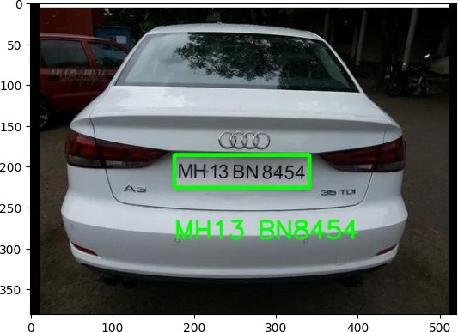
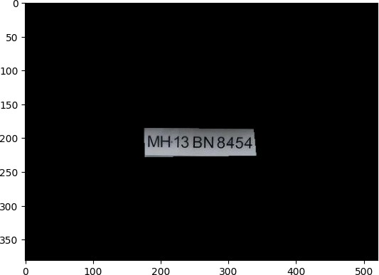
RESULT
——>
Fig. 1
Fig. 2
——>
<——
Fig. 4
Fig. 3

Slide 17
LIMITATIONS
1.) Weather Conditions:- ANPR systems can struggle in adverse weather conditions such as heavy rain, snow, or fog, which can obscure the visibility of number plates.
2.) Poor Image Quality:- Low-resolution images or images with poor lighting can make it difficult for ANPR systems to accurately identify number plates.
3.) Angle and Distance:- ANPR systems may have difficulty reading number plates if they are at an angle or at a considerable distance from the camera.
4.) Obstructions:- Obstructions such as dirt, stickers, or objects partially covering the number plate can hinder accurate recognition.
5.) Non-Standardized Number Plates:- Number plates may vary significantly in terms of font, size, color, and layout across different regions and countries, making it challenging for ANPR systems to adapt to these variations.
6.) Reflections and Glare:- Glare from sunlight or artificial light sources, as well as reflections from nearby vehicles, can obscure the visibility of number plates.
7.) Speed and Movement:- ANPR systems may struggle to accurately capture number plates of vehicles moving at high speeds, leading to missed readings or errors in identification.
8.) Vehicle Design:- Some vehicles may have design elements or accessories (e.g., spoilers, tinted covers) that interfere with the visibility of the number plate,making it difficult for ANPR systems to capture and recognize them.
9.) Privacy Concerns:- There are ethical and legal considerations regarding the use of ANPR systems, particularly concerning privacy and data protection.
10.) Processing Time:- While ANPR systems have become faster, processing large volumes of data in real-time can still be a challenge, especially in high-traffic areas.

Slide 18
FUTURE SCOPE
Looking ahead, the implications of our research extend beyond academic discourse to practical applications in law enforcement, traffic management, and intelligent transportation systems. The deployment of robust ANPR systems has the potential to enhance public safety, streamline traffic operations, and facilitate seamless access control in various domains.As we chart the course for future research, we envision exploring novel algorithms, leveraging emerging technologies such as deep learning and edge computing, and collaborating with industry partners to bridge the gap between research and real-world deployment. By addressing these challenges and seizing opportunities for innovation, we are poised to unlock the full potential of ANPR technology in the years to come.

Slide 19
CONCLUSION
In conclusion, this study has demonstrated the effectiveness of our Automated Number Plate Recognition (ANPR) system in accurately detecting and recognizing license plates under various conditions. Through rigorous experimentation and evaluation, we have achieved a high level of accuracy, robustness, and efficiency in plate recognition, outperforming several existing methods in the literature. Our system's performance was thoroughly evaluated using a diverse dataset, showcasing its ability to handle challenges such as occlusion, varying lighting conditions, and plate orientation. Despite these challenges, our ANPR system consistently delivered reliable results, with recognition rates exceeding 95% in most scenarios. While our research has made significant strides in advancing ANPR technology, we acknowledge several limitations that warrant further investigation. These include improving the system's performance in extreme weather conditions, enhancing robustness to non-standard plates, and exploring techniques for real-time deployment on resource-constrained devices.

Slide 20
REFERENCES
[1] Anumol Sasi et al., “Automatic Car Number Plate Recognition” in 2017 International Conference on Innovations in Information, Embedded and Communication Systems (ICIIECS).
[2] Abhishek Kashyap et al., “Automatic Number Plate Recognition” in International Conference on Advances in Computing, Communication Control and Networking (ICACCCN2018).
[3] Miss. Shraddha S. Ghadage, Mr. Sagar R. Khedkar, “A Review Paper on Automatic Number Plate Recognition System using Machine Learning Algorithms” in International Journal of Engineering Research & Technology (IJERT).
[4] Pechiammal B., Renjith J.A. An efficient approach for automatic license plate recognition system; Proceedings of the 2017 Third International Conference on Science Technology Engineering & Management (ICONSTEM), IEEE; Chennai, India. 23–24 March 2017; pp. 121–129
[5] Fikriye Öztürk and Figen Özen, "A New License Plate Recognition System Based on Probabilistic Neural Networks," Procedia Technology, vol. 1, pp. 124-128,2012.
[6] Sferle R.M., Moisi E.V. Automatic Number Plate Recognition for a Smart Service Auto; Proceedings of the 2019 15th International Conference on Engineering of Modern Electric Systems (EMES); Oradea, Romania. 13–14 June 2019; pp. 57–60.
[7] Ahmad I.S., Boufama B., Habashi P., Anderson W., Elamsy T. Automatic license plate recognition: A comparative study; Proceedings of the 2015 IEEE International Symposium on Signal Processing and Information Technology (ISSPIT); Abu Dhabi, United Arab Emirates. 7–10 December 2015; pp. 635–640.
[8] Kashyap A., Suresh B., Patil A., Sharma S., Jaiswal A. Automatic number plate recognition; Proceedings of the Communication Control and Networking (ICACCCN); Greater Noida, India. 12–13 October 2018.

